Slide 1
The ‘inequality space’ and contemporary research challenges
Mike Savage

Slide 2
The ‘inequality space’
Concerns about inequality have dramatically surged into public interest over past decade, led by economists Stiglitz, Atkinson, Piketty.
Considerable academic investment in cross-disciplinary research in this area, e.g
  LSE, International Inequalities Institute
  World Wealth and Income Database (loosely based in Paris)
  US centres at Stanford, Harvard, CUNY, Cornell, etc
Repackaging of poverty/development initiatives around inequality
  Oxfam; Young Foundation
  Manchester, Global Development Institute
New wave of civil society organisations addressing inequality
  Equality Trust; Resolution Foundation; Institute for Policy Studies

Slide 3
The philanthropic moment….
Institute for New Economic Thinking – major investments from Soros & other philanthropists
LSE III - £65 million from Atlantic Philanthropies, (together with other Atlantic investments
Ford Foundation, Gates, Zuckerberg and other have all emphasised their determination to address inequality
BUT – be aware of the complex issues around philanthropic investment (Lynsey McGoey).

Slide 4
LSE’s Atlantic Fellows programme
Arises out of concerns with escalating inequalities, and their spill over into all aspects of democratic life.
Draws on LSE’s proud history of critical social science, concerned with equity, citizenship, and human rights
Based in the International Inequalities Institute, founded in 2015 to bring together scholars from across the LSE and which houses
  Successful 1 year Masters programme
  Doctoral programme funded by Leverhulme Trust
  Numerous research projects
Directed by Bev Skeggs, with Rana Zincir Celal as Deputy Director
Involves other academic nodes (UCT) and non-academic collaborating partners (e.g. Oxfam, Center for Community Change, Young Foundation, etc)

Slide 5
III Atlantic Fellows experience
All III Atlantic fellows participate in Summer school, mentorship, conference, workshops, projects
Residential Fellows also do MSc course
Non-residential Fellows also do 3-4 short courses
Visiting Fellows also undertake an LSE residency

Slide 6
But
Major research councils have NOT asked for major bids directly in the area of inequality….. (e.g. Global Challenges Research Fund)
There is intellectual ‘kick back’ away from inequality agenda, due to
  How do we move from patterns to analysis?
  Theoretical concerns towards Piketty’s neo-classical economics
  Diffuseness of the inequality ‘agenda’ which can make it hard to crystallise specific issues
  Has (income) inequality peaked?

Slide 7
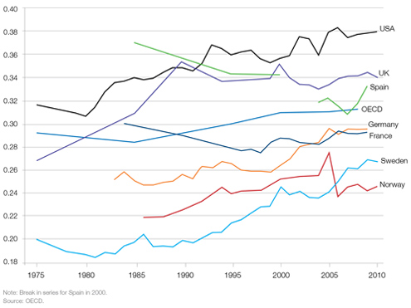
1: Income inequality trends in many leading nations are now mixed
Gini coefficients generally rose 1985 to 2000, have steadied since then

Slide 8
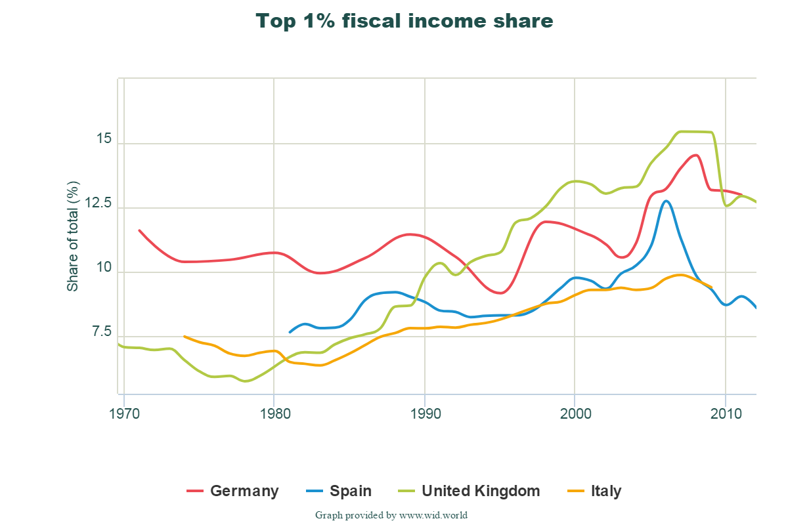
Many European nations show falling inequality since 2008

Slide 9
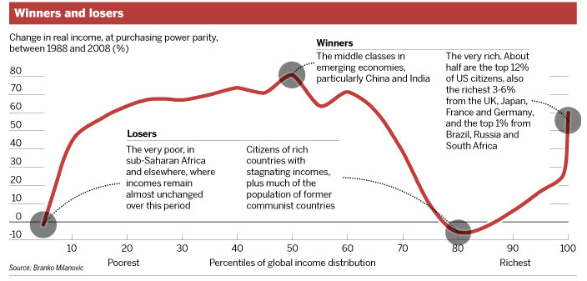
Milanovic’s global analysis

Slide 10
The new and emerging agenda?
1: A truly global comparative approach
Different parts of the world have very different inequality trajectories, and we can learn from these comparative experiences
e.g. Latin American decline of inequality
Return of the urban – rural divide?
  Within many nations, gaps between leading cities and other parts of nations is increasing, suggesting new spatial patterns
Significance of migration and diaspora

Slide 11
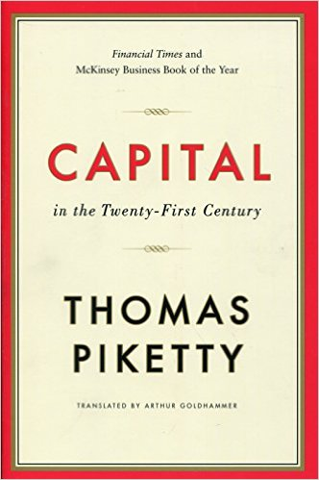

2: wealth inequalities are accumulating and endemic: we need to know more about these dimensions

Slide 12
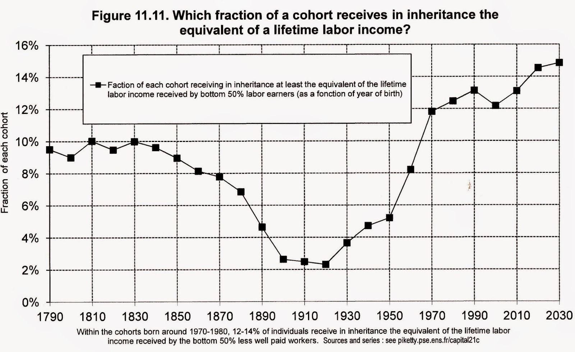
The inheritance time bomb….
How many French can expect to inherit 750,000 euros?
No one really knows how this will affect social mobility, but there are strong reasons to think it will allow the inheritors to draw on extra resources and allow further elite closure

Slide 13
Wealth inequality……
Shift from income inequality to wealth & inheritance involves major intellectual shifts
  Towards age/ household/ familial dynamics
  Questioning of meritocratic underpinnings of contemporary society
  Rethinks the significance of elites and privilege

Slide 14
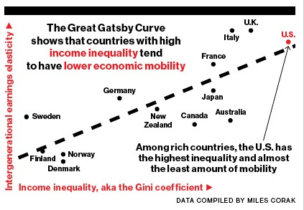
3: Rising absolute as well as relative inequality has major spill overs
Countries which are more unequal, have lower social mobility – it is harder to get from the bottom to the top….

Slide 15
Key spill over issues….
Future of democratic polities
Resurgence of racism, xenophobia and nationalism
Changing cultural forms – ‘performance’, ‘new snobbery’, etc

Slide 16
Finally…..
The issue of inequality does permit new synergies across disciplines, but these still remain tentative - more needs to be done……
The rethinking of economics is a key and urgent issue – and there are encouraging developments here, e.g. CORE econ initiative

